Slide 1
Natural Language Processing for Reading Papers
Logan Ward Asst. Computational Scientist Argonne National Laboratory
3 March 2022

Slide 2
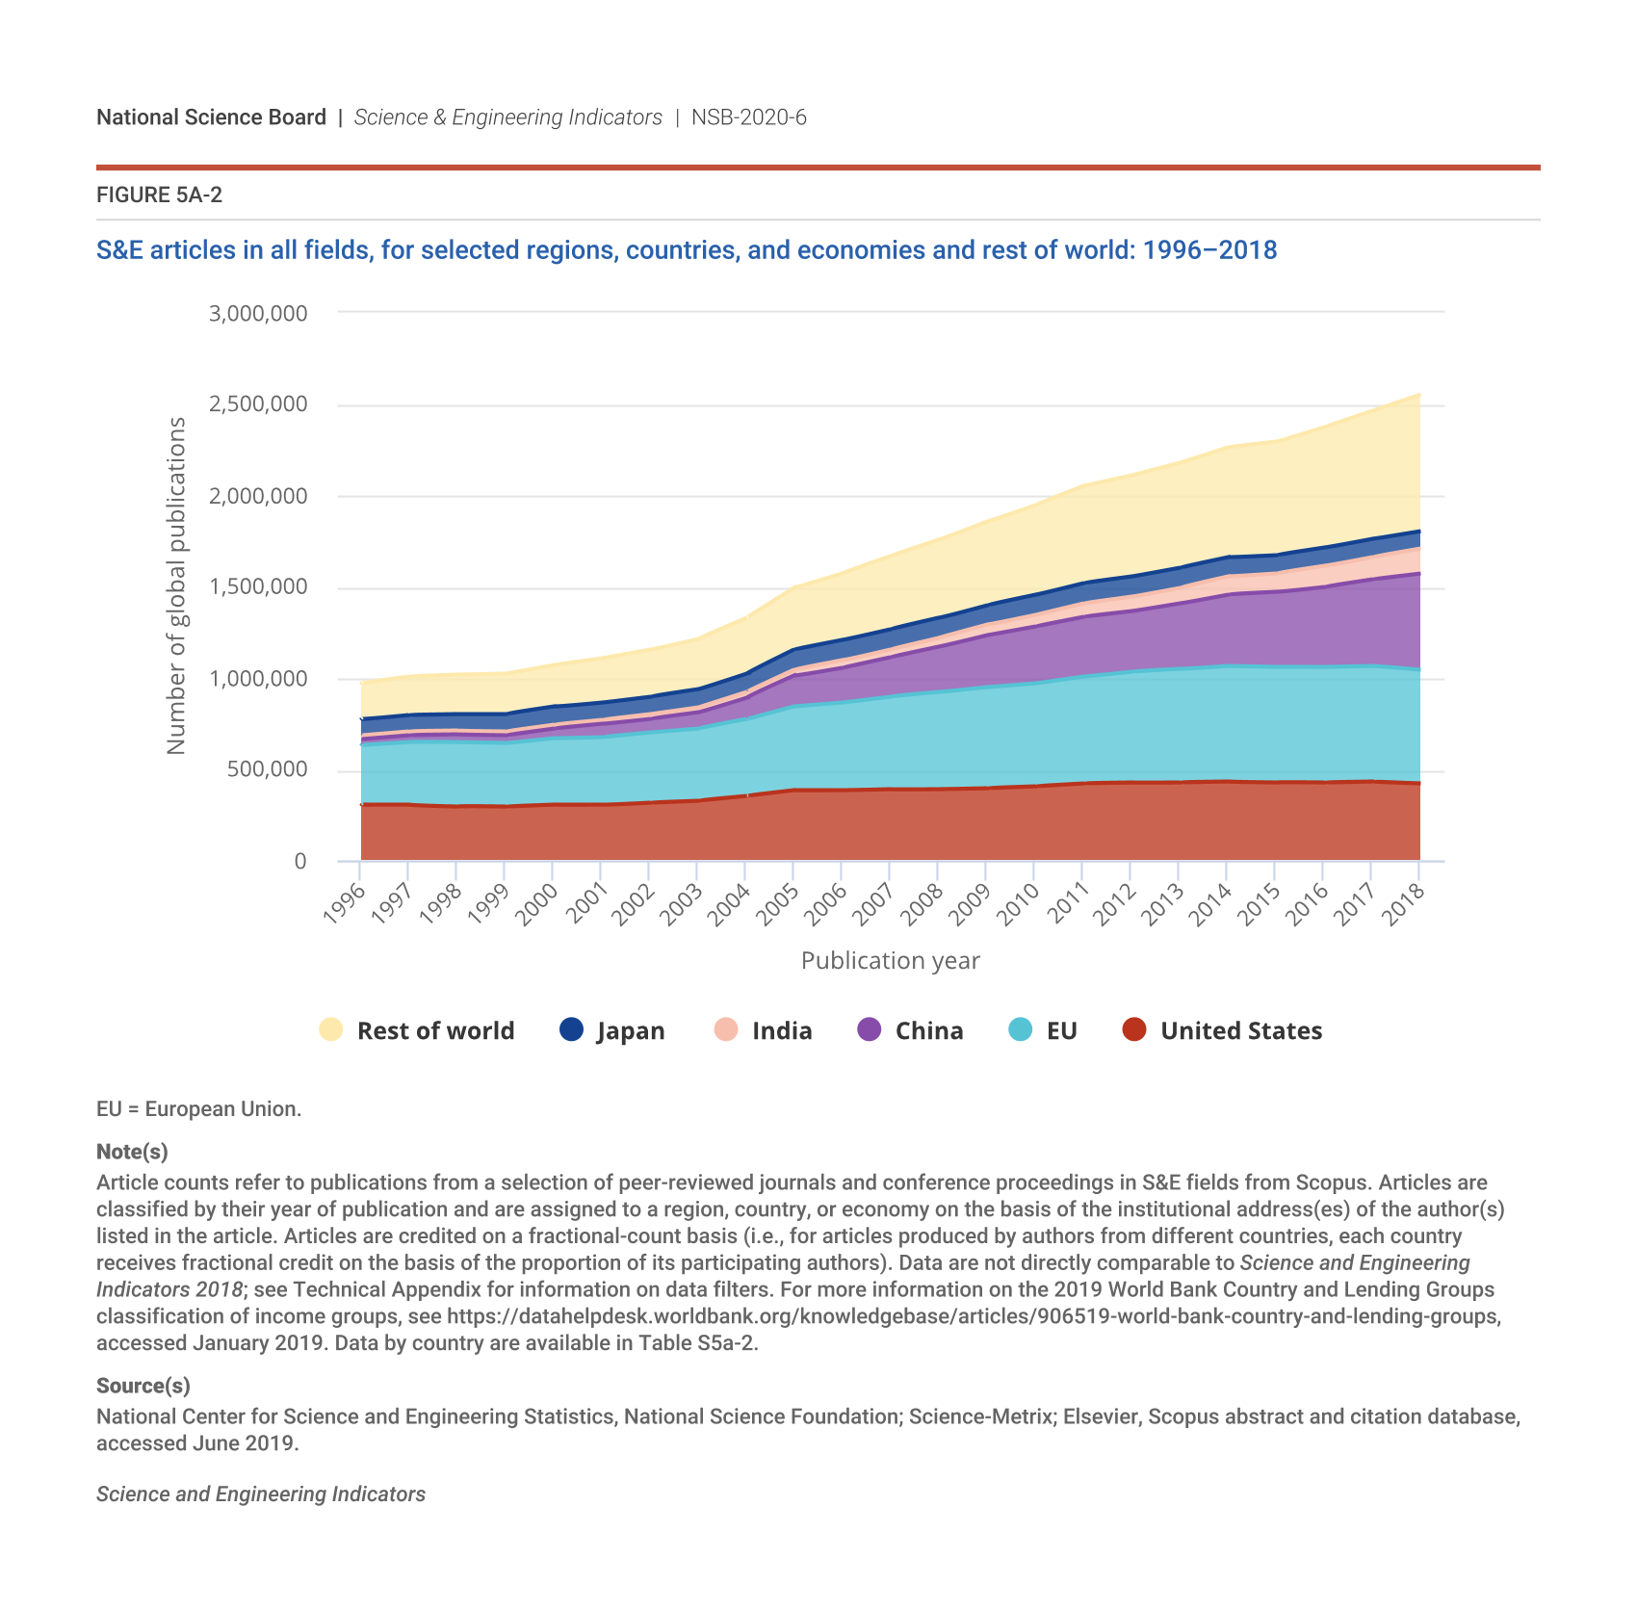
Scientific literature is a deluge
2.5M science and engineering articles per year!
My Mendeley has 1086 articles, and I would be generous to claim I had mastery of half of them
Computers are needed to manage this, but how!?

Slide 3
Step 1: Define tasks (of roughly greater complexity)
Semantic Search: Being able to search based on meaning
Information Extraction: Get data out of text
Summarization: Creating summarizes of certain text
Question Answering: Generating responses to queries
Logical Reasoning: Identifying conflicting data, testing theories

Slide 4
Basics of NLP for information Extraction
Understanding “natural” text is hard.

Slide 5
What tasks go into information extraction?
High-density polyethylene has a glass-transition temperature of –110 C.
"Named Entity Recognition"
“polyethylene“ is a polymer
“glass-transition temperature" is a property
"Relationship Extraction"
"polyethylene" has a characteristic "high-density"
"glass-transition temperature" has a value "-110"
"-110" has units of "C"
"polyethylene" has a property “glass-transition temperature”
{
"material": "polyethylene",
"processing": {
"density": "high
},
"properties": {
"t_g": {
"value": -110.,
"units": "C"
}
}
}

Slide 6
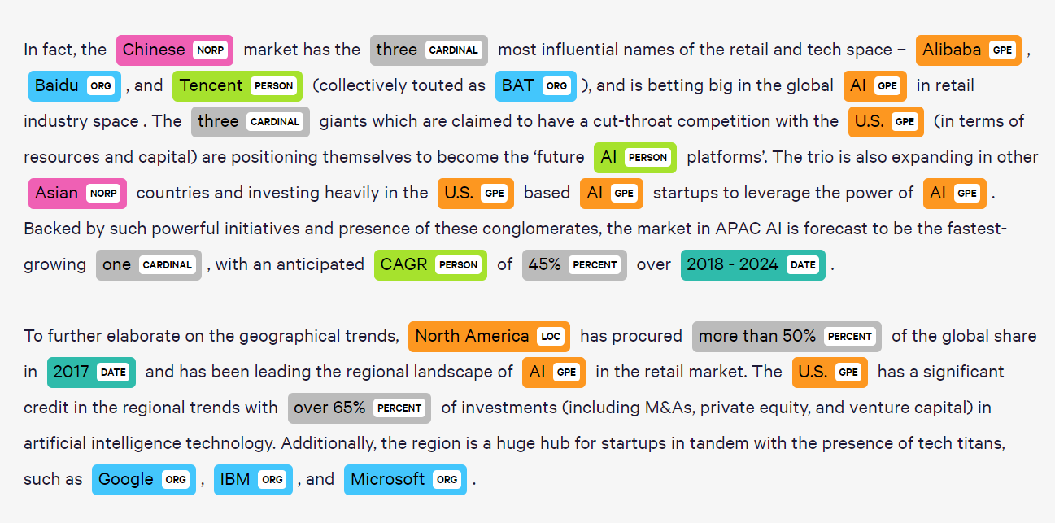
Let's consider one problem: Named-Entity Recognition
Named Entity Recognition (NER) is a supervised learning problem
Inputs: A word [and maybe its context]
Output: Category classifications
Examples:
Is Apple a noun?
Is that noun a person, place or thing?
Solvable with machine learning, if would could turn a word into "features..."
Source: Medium blog

Slide 7
Word embeddings are features
Idea 1: One input per word
Idea 2: Embed words with meaning
boat
canoe = [1, 0, 0, 0]
ship = [0, 1, 0, 0]
bike = [0, 0, 1, 0]
car = [0, 0, 0, 1]
Size
car
bike
canoe
Buoyancy
Problem: Information lean!
>10⁵ features for some languages
Mutually orthogonal for each word
Problems are fixed!
Arbitrary number of features
Feature vectors encode meaning

Slide 8
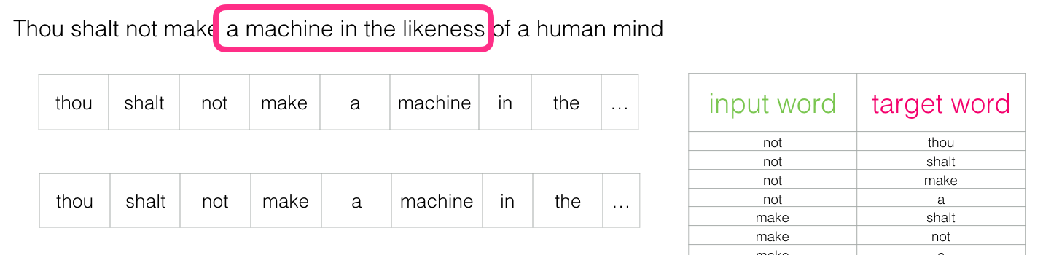
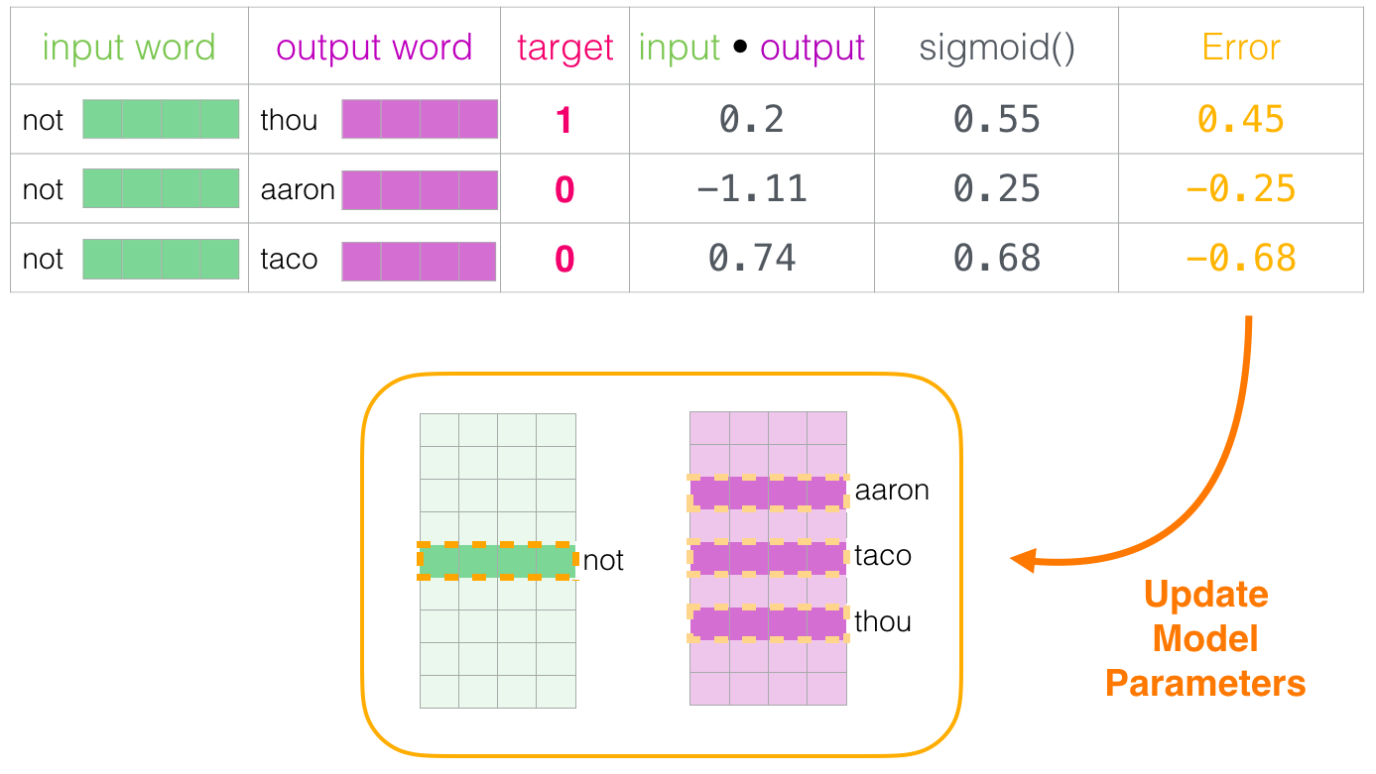
Embeddings are from "unsupervised learning"
General concept: Related words have similar contexts
One way to use this concept? Learn a word-prediction model with "skipgram"
Get contexts of words in text (positives)
Get random pairs of unrelated words (negatives)
Assign each word a random embedding
Iteratively update the embeddings
Source: Jay Alammar's excellent blog (and great taste in Sci-Fi); d2l.ai/chapter_natural-language-processing

Slide 9

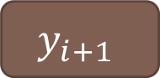





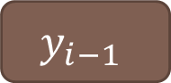



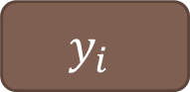
Learning a NER model
Smart
Smarter
Smartest!
Use a single word
Use its context
Use the whole sentence
$$w_{i}$$
$$w_{i−1}$$
$$w_{i}$$
$$w_{i+1}$$
$$w_{i−1}$$
$$w_{i}$$
$$w_{i+1}$$
NER
NER
NER
NER
NER
$$y_{i}$$
$$y_{i}$$
$$y_{i−1}$$
$$y_{i}$$
$$y_{i+1}$$

Slide 10

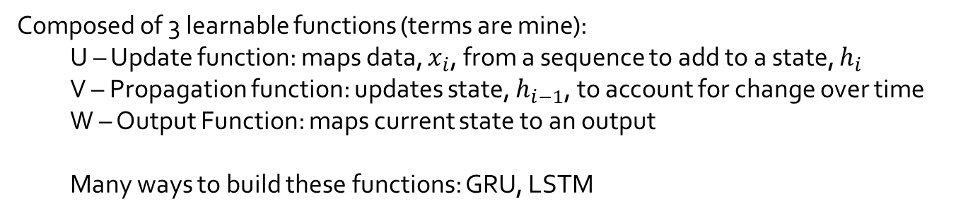
Recurrent neural networks (RNNs)
RNNs learn how a hidden state “$h$“ evolves with a sequence of data ($x$)
Composed of 3 learnable functions (terms are mine):
U – Update function: maps data, $x_{i}$, from a sequence to add to a state, $h_{i}$
V – Propagation function: updates state, $h_{i−1}$, to account for change over time
W – Output Function: maps current state to an output
Many ways to build these functions: GRU, LSTM
Source: Wikipedia

Slide 11
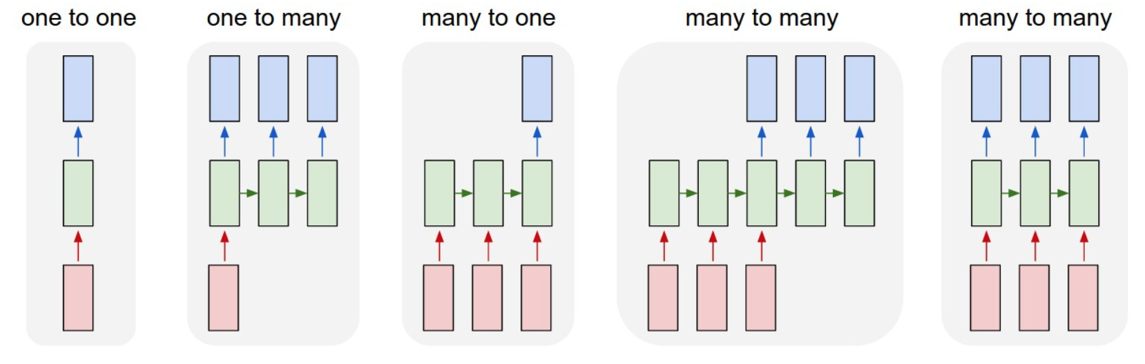
RNNs are very configurable
Source: Sahal Nair's Blog

Slide 12

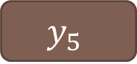

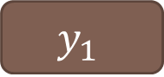
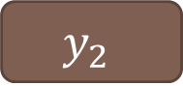

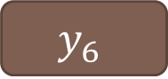



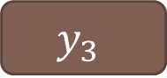

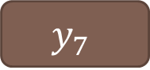

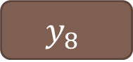

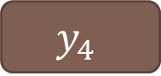

Example for NER and “bi-directional” RNN
High-density | polyethylene | has | a | glass-transition | temperature | of | -110 | C
Retrieving embeddings
$$w_{0}$$
$$w_{1}$$
$$w_{2}$$
$$w_{3}$$
$$w_{4}$$
$$w_{5}$$
$$w_{6}$$
$$w_{7}$$
$$w_{8}$$
RNN
RNN
RNN
RNN
RNN
RNN
RNN
RNN
RNN
$$y_{0}$$
$$y_{1}$$
$$y_{2}$$
$$y_{3}$$
$$y_{4}$$
$$y_{5}$$
$$y_{6}$$
$$y_{7}$$
$$y_{8}$$
“y” is a probability
High-density | polyethylene | has | a | glass-transition | temperature | of | -110 | C

Slide 13
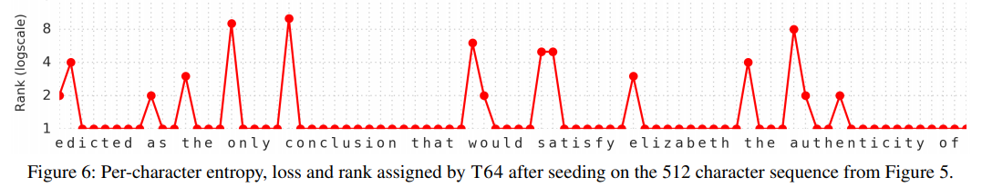
Avoiding out-of-vocabulary words
You can do “character-level” versions of RNNs as well
Require bigger models and more training data, but offer great flexibility
Source: Al-Rfou et al. AAAI (2019)

Slide 14
Can make crazy-complicated models from characters
Q: What is your favorite animal?
Q: Why?
Q: Are there any animals with three legs?
Q: Why don’t animals have three legs?
A: My favorite animal is a dog.
A: Because dogs are loyal and friendly
A: No, there are no animals with three legs
A: Animals don’t have three legs because they would fall over
Q’s from Kevin Lacker (a human) and A’s from GPT-3 a language model (see blog)

Slide 15



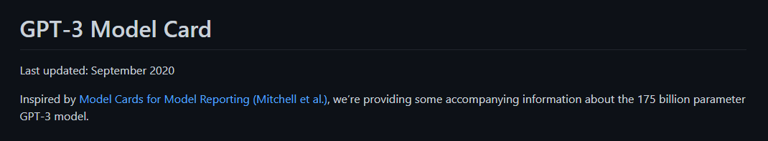
Last word: There are super-well-used codes for NLP
Codes for processing language data
Ways to label data easily
Pretrained language models
Google twice before trying to code something yourself

Slide 16
Recent history of NLP in materials Engineering

Slide 17
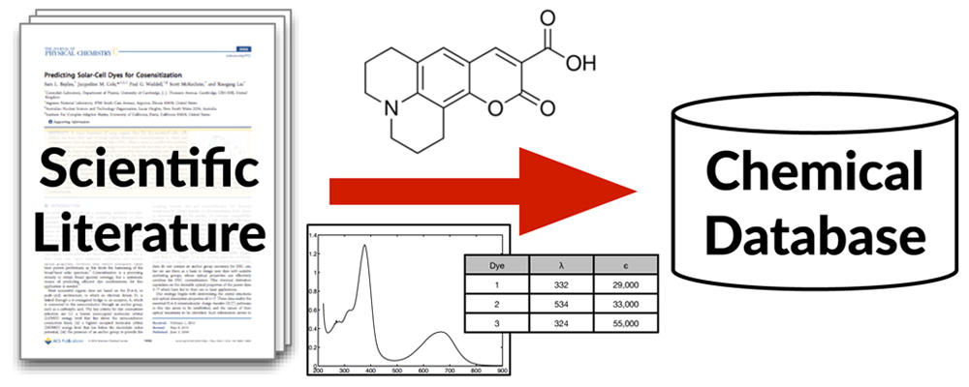
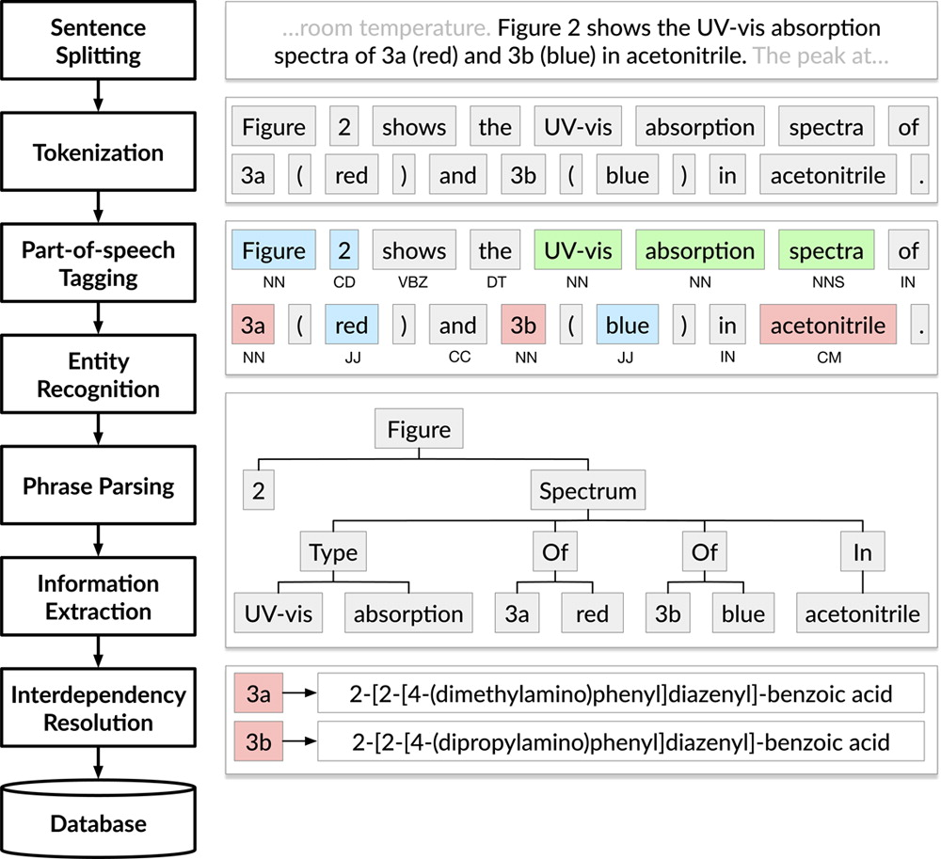
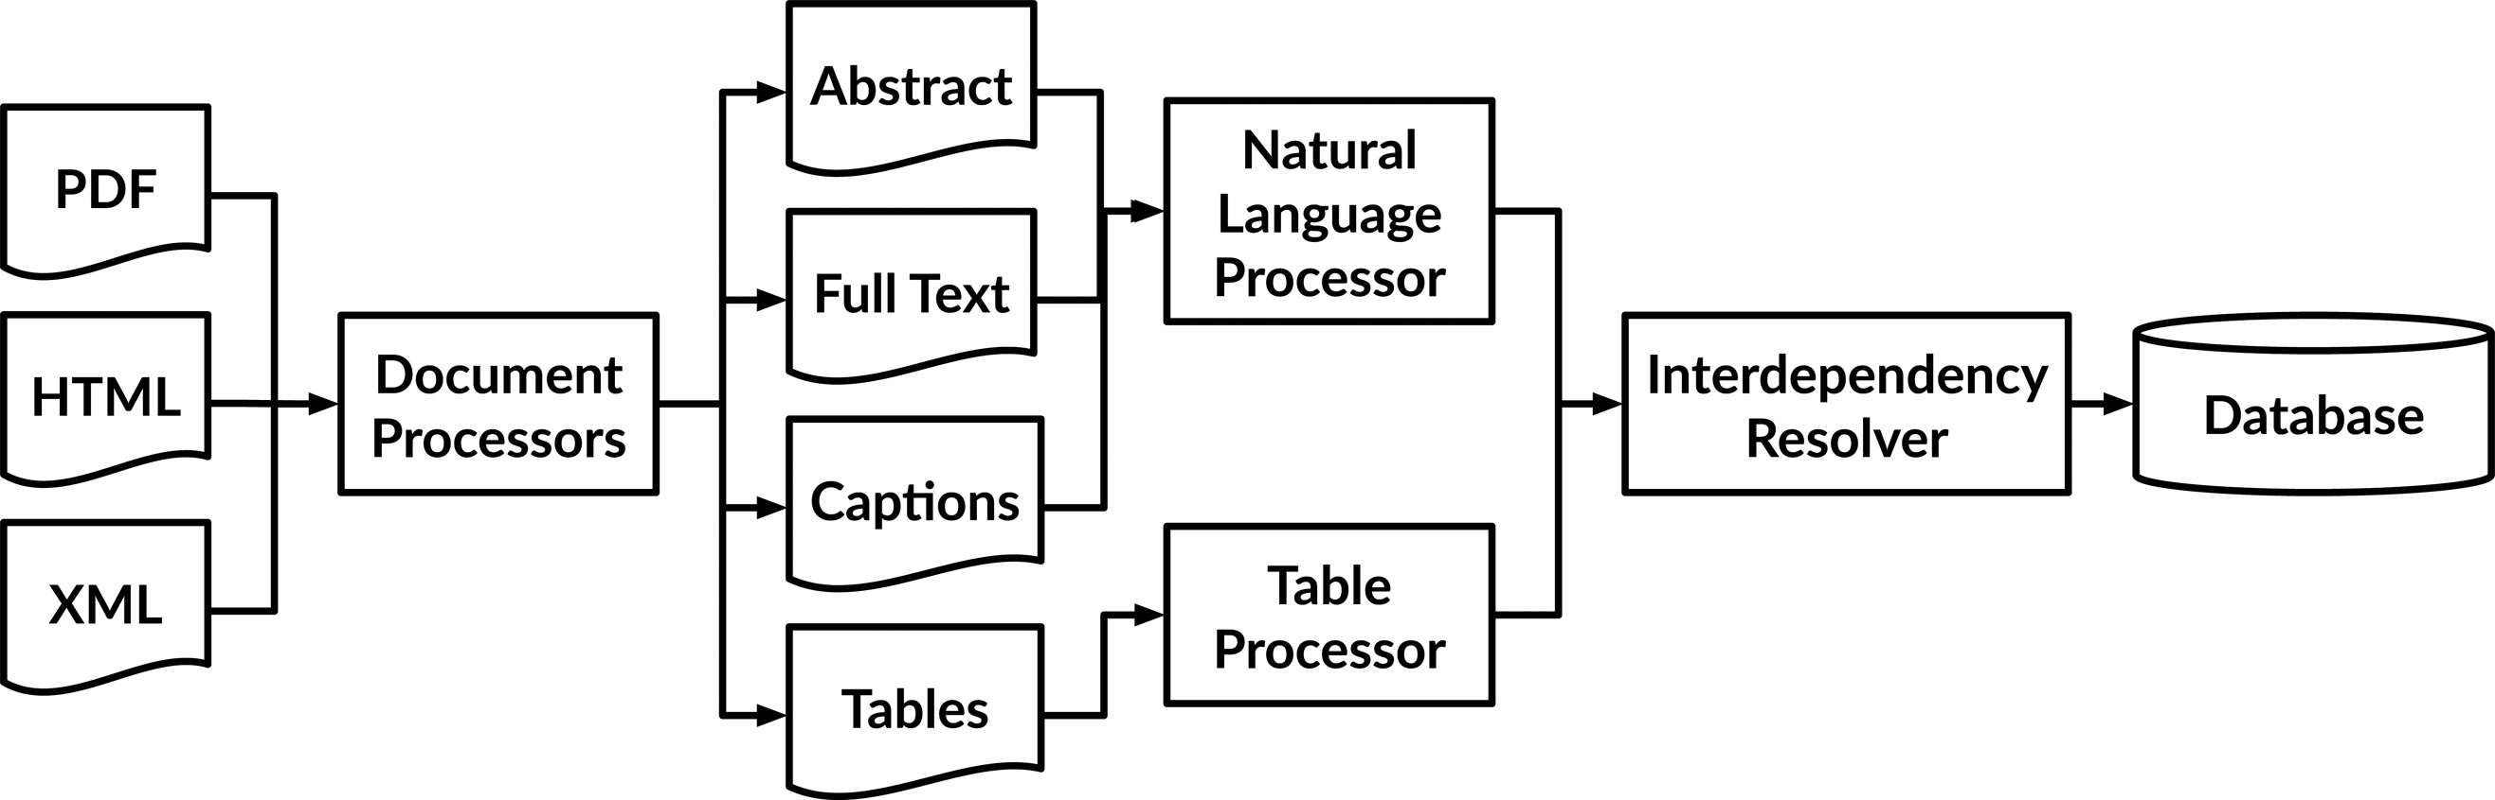
ChemDataExtractor (Swain and Cole, 2016)
Many moving parts to getting chemical data from papers
Parsing documents is a challenge…
…but we’ll focus on the NLP part

Slide 18
NLP required a lot of thought in many different steps
Does “et al.” mark the end of a sentence?
Is “poly(ethylene glycol)” 1 or three words?
Do I train a POS tagger on newspapers or MEDLINE abstracts?
Do I train a NER on newspapers or MEDLINE abstracts?
Source: Cole and Swain. JCIM (2016)

Slide 19
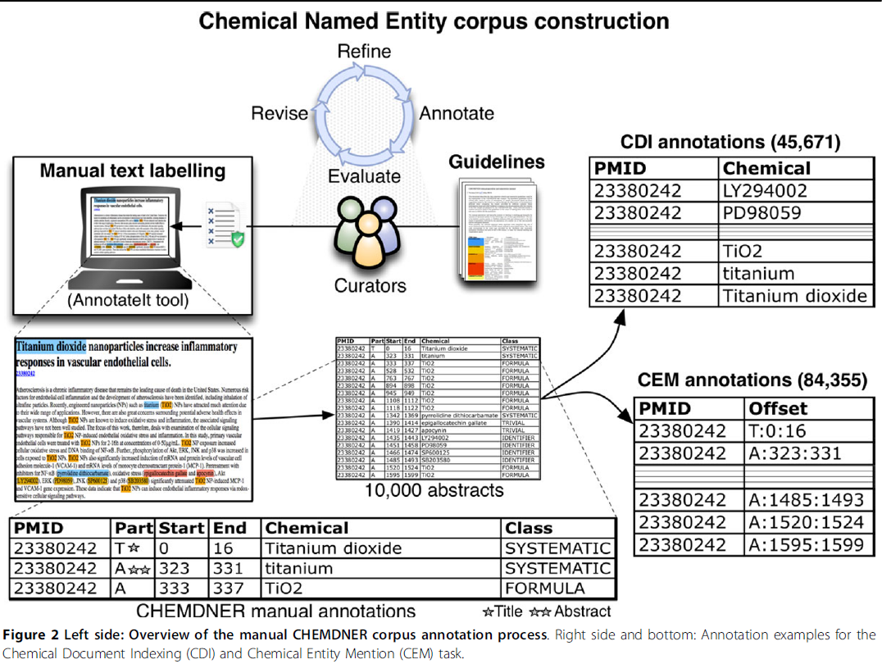
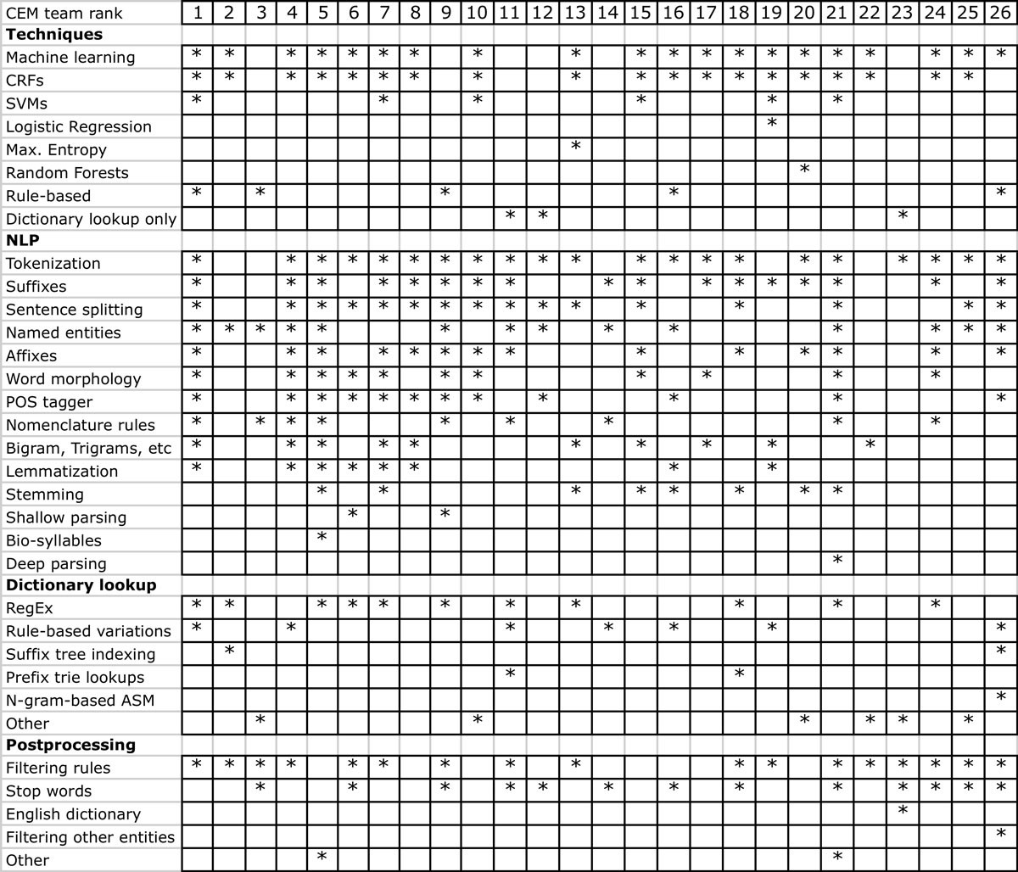
CHEMDNER: Labeled abstracts for chemical NER
Labeled dataset of 10k abstracts
Used to create dozens of ML engines
Source: Krallinger et al. JCI (2015)

Slide 20
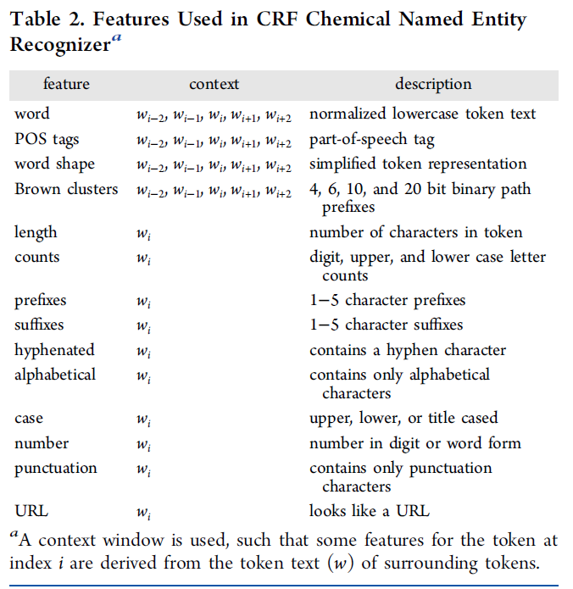
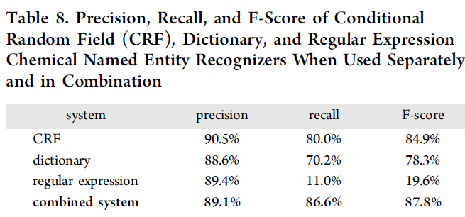
ChemDataExtractor: ML + Dictionary for NER
CRF is a sequence/graph-based ML technique
An embedding, like word2vec
Character-level features about words
Better performance by adding rules/dictionaries
Source: Cole and Swain. JCIM (2016)

Slide 21
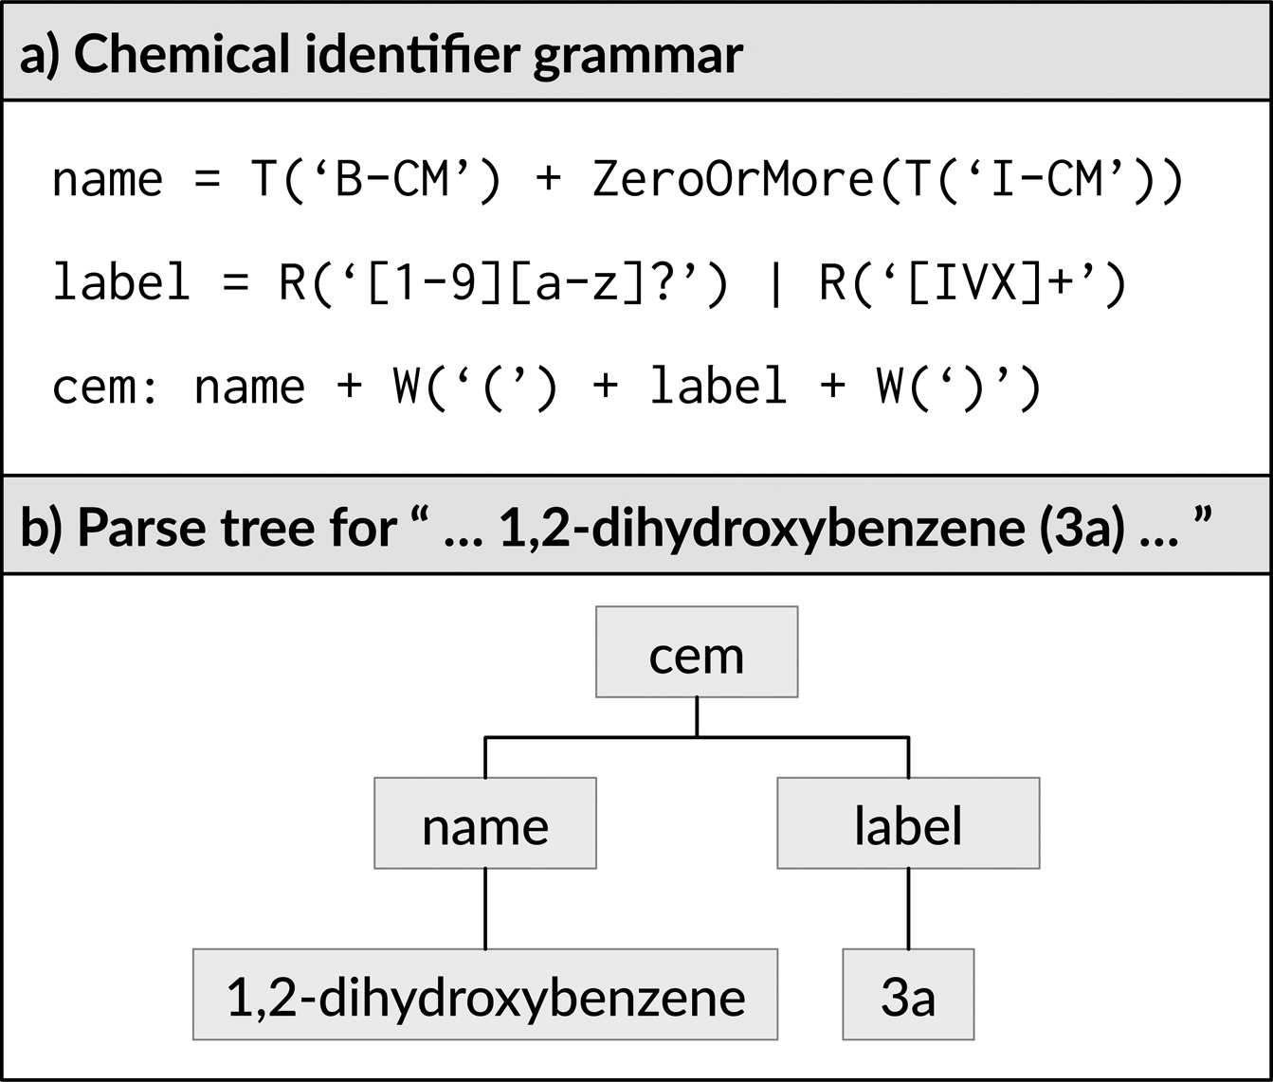
Rule-based association engine
Associations between entities are assigned with rules
Source: Cole and Swain. JCIM (2016)

Slide 22
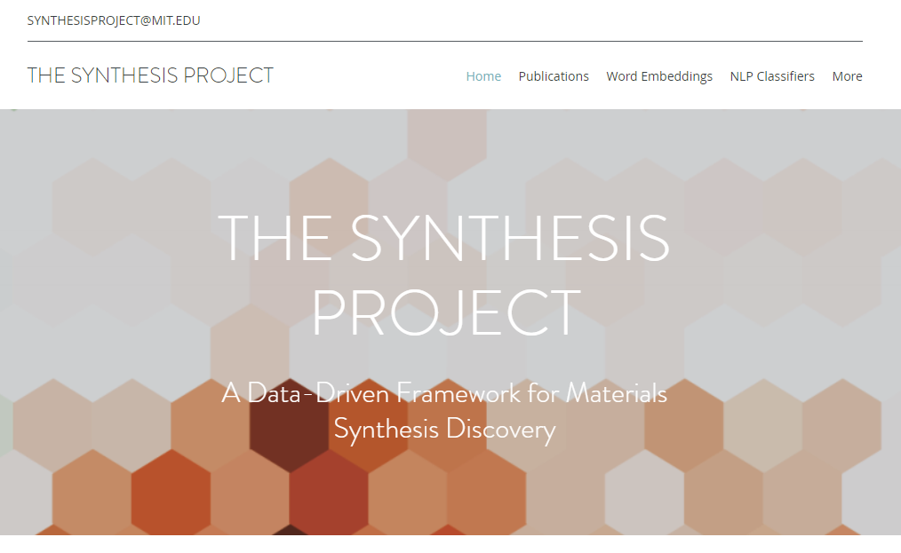
The Synthesis Project
Full stack of NLP tools: Word embeddings, NER tools, labeled datasets!
Tour de force of using text for ML for materials and shining example of openness
Source: https://www.synthesisproject.org/

Slide 23
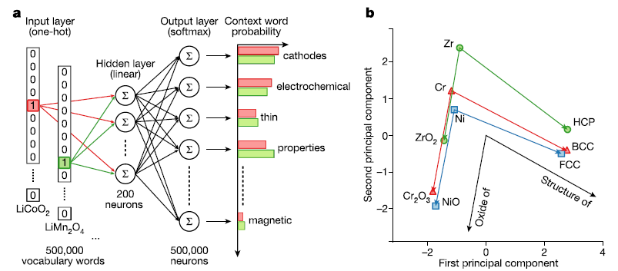
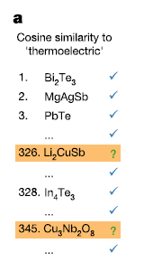
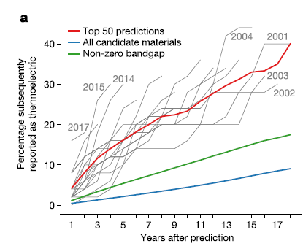
MatScholar: Disovery using word embeddings
Encoding knowledge of materials space using word embeddings
No labelling required
Just learning how materials are described
Embeddings can predict good materials.
Of the Top 50 materials similar to “thermoelectric” based on pre-2000 papers, 40% have been discovered to be thermoelectrics
Source: Tshitoyan et al. Nature (2019)

Slide 24
Avoiding NLP
Humans can make text more understandable if they just wrote better!

Slide 25
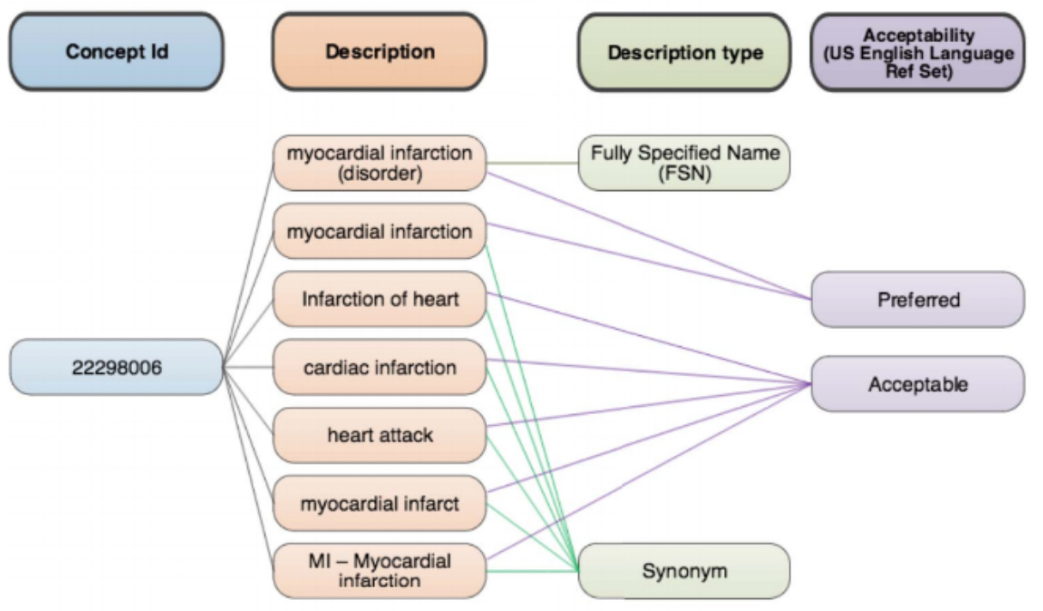
Ontologies/Controlled Vocabularies
Some communities enforce precision in language
SNOMED CT: Definition of medical terms and mappings between them
Used to be able to quickly “understand” words
Careful annotation of terms obviates need to learn meanings with data
https://www.snomed.org/snomed-ct/five-step-briefing

Slide 26
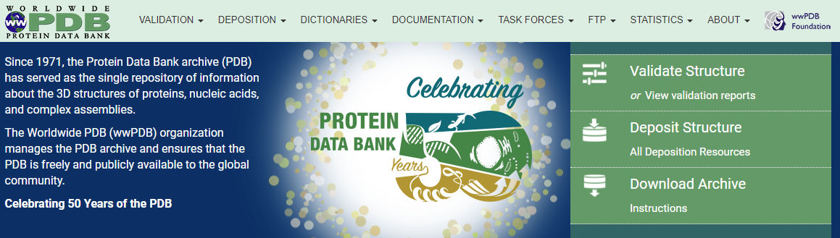
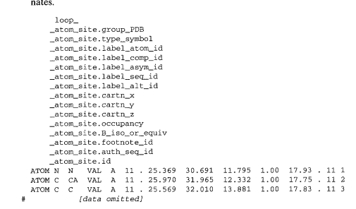
Skipping natural language: Publish structured data
If you want to publish a paper about a crystal structure, you must publish it to PDB
Data must be in a machine-accessible format and available on the internet. No need for NLP!
Figure: Bourne et al. Methods in Enzy. (1997)

Slide 27
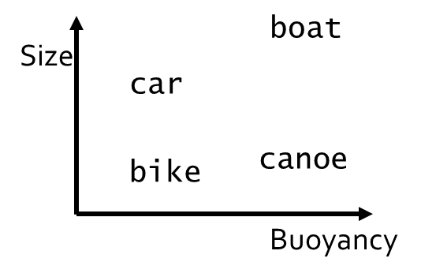
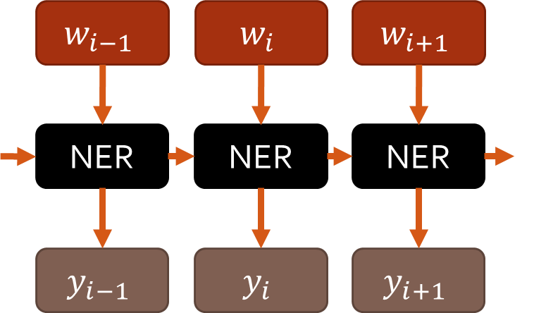
Take away points
Core Concepts in NLP
Core Applications
Many individual challenges
Named-entity recognition
Association mapping
Translation
Question Answering
Two core methods:
Embeddings
Recurrent networks
Information Extraction
Unsupervised Learning
Source: Cole and Swain. JCIM (2016)
Source: Tshitoyan et al. Nature (2019)

